Slide 1
Theory of Automata (CSC- 402) Semester : Spring 2026 Credit Hours: 3

Slide 2
Theory of Automata Course
Lecture 3

Slide 3
CHAPTER 2 - Languages
Overview

Slide 4
Recap
Language
Empty String
Power of string
Length of string
Reverse of a string
Concatenation
Palindrome
Kleene star

Slide 5
Kleen Star/Closure/Operator VS. Kleener Closure/Plus/Positive, Lexicographic Order
In the first lecture, we discussed about power of alphabet, and poower of string which are:
Then we learn about Kleene star, kleene closure, kleene operator.

Slide 6
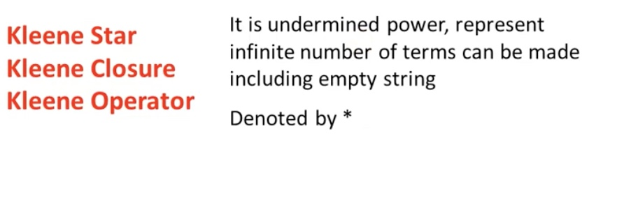
Kleene Star/Closure/Operator

Slide 7
Kleene Plus/Psitive/Closure
It is undermined power, represent infinite number of terms can be made except empty string.
It is denoted by +
What are the possible values of ba⁺b?

Slide 8
Lexicographic Order
We arrange the terms on the basis of shortest length first.
Defination: Method of sequencing a language in which strings are grouped by their length (i.e., strings of shortest legth first)

Slide 9
Formal Language Vs Informal Language
Language is : set of strings with rules
- What is the correct word ?
work, wkro ?
- Language 1 : Start with w and end with o?
Now which one is correct?

Slide 10
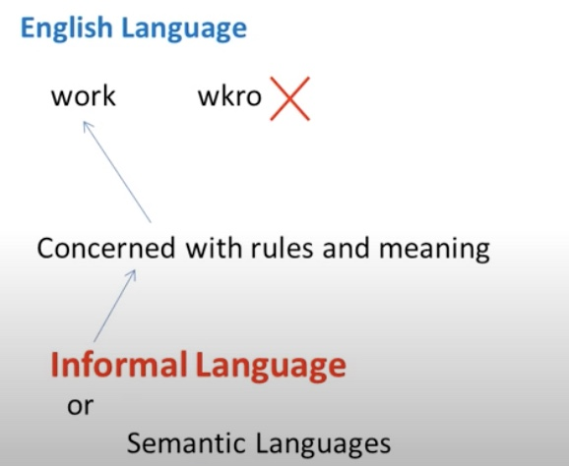
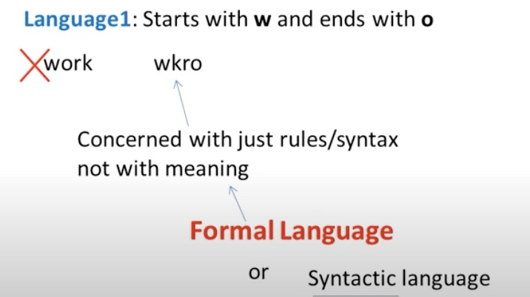
Formal Language Vs Informal Language
Automata focuses on formal language.

Slide 11
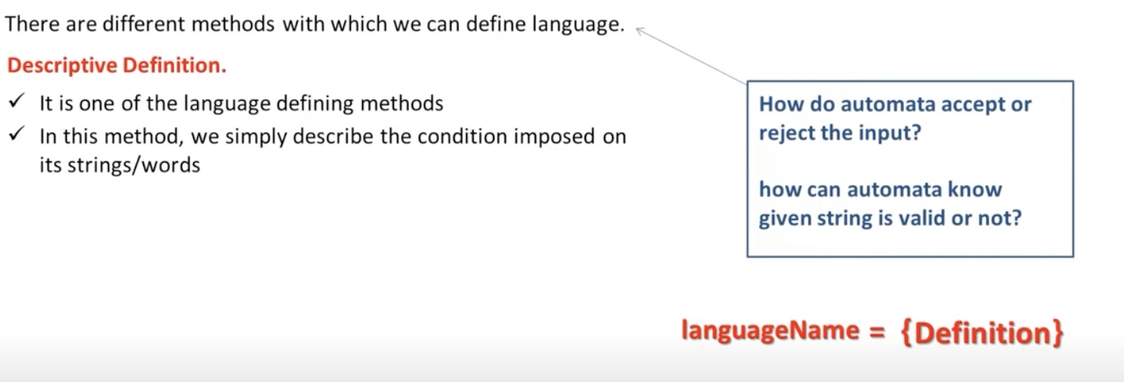
Descriptive Defination in Automata

Slide 12
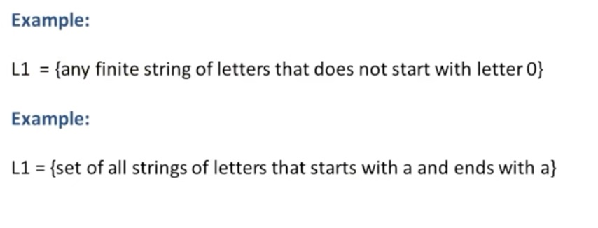
Example ∑ = {0,1,2,3,4,5,6,7,8,9,10}
∑ = {a,b}

Slide 13
CHAPTER 3 - Recursive Definations Overview

Slide 14
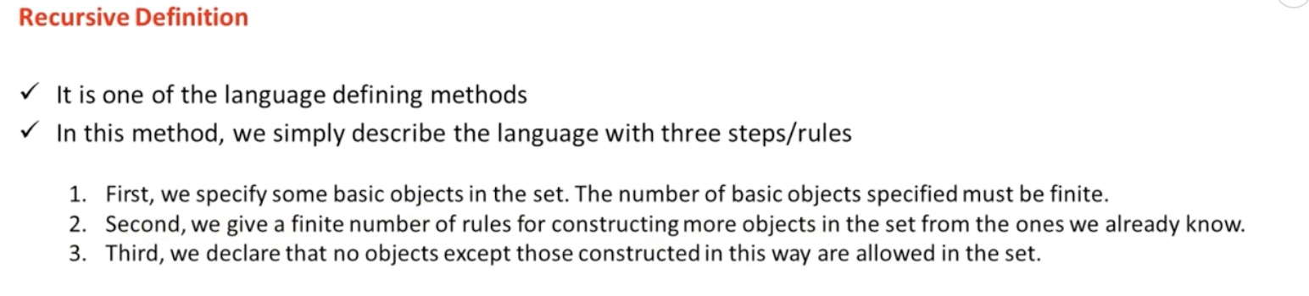
Recursive Defination in Automata

Slide 15
Defining Languages Continued…
Recursive definition of languages
The following three steps are used in recursive definition
Some basic words are specified in the language.
Rules for constructing more words are defined in the language.
No strings except those constructed in above, are allowed to be in the language.

Slide 16
Example
Defining language of INTEGER
Step 1:
1 is in INTEGER.
Step 2:
If x is in INTEGER then x+1 and x-1 are also in INTEGER.
Step 3:
No strings except those constructed in above, are allowed to be in INTEGER.

Slide 17
Example
Defining language of EVEN
Step 1:
2 is in EVEN.
Step 2:
If x is in EVEN then x+2 and x-2 are also in EVEN.
Step 3:
No strings except those constructed in above, are allowed to be in EVEN.

Slide 18
Example
Defining the language factorial
Step 1:
As 0!=1, so 1 is in factorial.
Step 2:
n!=n*(n-1)! is in factorial. n= 1,2,3,…….
Step 3:
No strings except those constructed in above, are allowed to be in factorial.

Slide 19
Example
Defining the language PALINDROME, defined over Σ = {a,b}
Step 1:
a and b are in PALINDROME
Step 2:
if x is palindrome, then axb and bxb will also be palindrome
Step 3:
No strings except those constructed in above, are allowed to be in palindrome

Slide 20
Example
Defining the language {a^{n}b^{n} }, n=1,2,3,… , of strings defined over Σ={a,b}

Slide 21
Example
Defining the language {a^{n}b^{n} }, n=1,2,3,… , of strings defined over Σ={a,b}
Step 1:
ab is in {a^{n}b^{n}}
Step 2:
if x is in {a^{n}b^{n}}, then axb is in {a^{n}b^{n}}
Step 3:
No strings except those constructed in above, are allowed to be in {a^{n}b^{n}}

Slide 22
Example
Defining the language L, of strings ending in a , defined over Σ={a,b}

Slide 23
Example
Defining the language L, of strings ending in a , defined over Σ={a,b}
Step 1:
a is in L
Step 2:
if x is in L then (x)a is also in L, x belong to ∑ *
Step 3:
No strings except those constructed in above, are allowed to be in L

Slide 24
Example
Defining the language L, of strings beginning and ending in same letters , defined over Σ={a, b}

Slide 25
Example
Defining the language L, of strings beginning and ending in same letters , defined over Σ={a, b}
Step 1:
a and b are in L
Step 2:
(a)s(a) and (b)s(b) are also in L, where s belongs to Σ*
Step 3:
No strings except those constructed in above, are allowed to be in L

Slide 26
Example
Defining the language L, of strings containing aa or bb , defined over Σ={a, b}

Slide 27
Example
Defining the language L, of strings containing aa or bb , defined over Σ={a, b}
Step 1:
aa and bb are in L
Step 2:
s(aa)s and s(bb)s are also in L, where s belongs to Σ*
Step 3:
No strings except those constructed in above, are allowed to be in L

Slide 28
Example
Defining the language L, of strings containing exactly aa, defined over Σ={a, b}

Slide 29
Example
Defining the language L, of strings containing aa or bb , defined over Σ={a, b}
Step 1:
aa and bb are in L
Step 2:
s(aa)s is also in L, where s belongs to b*
Step 3:
No strings except those constructed in above, are allowed to be in L

Slide 30
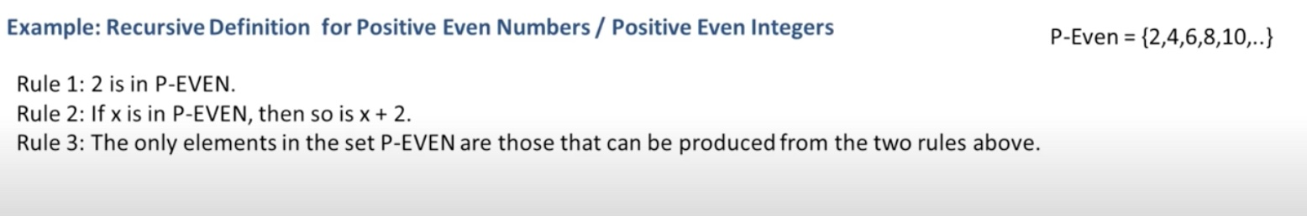
Example

Slide 31
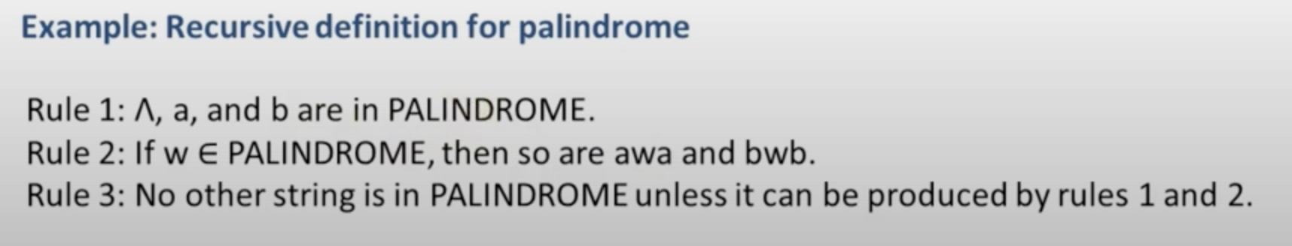
Example

Slide 32
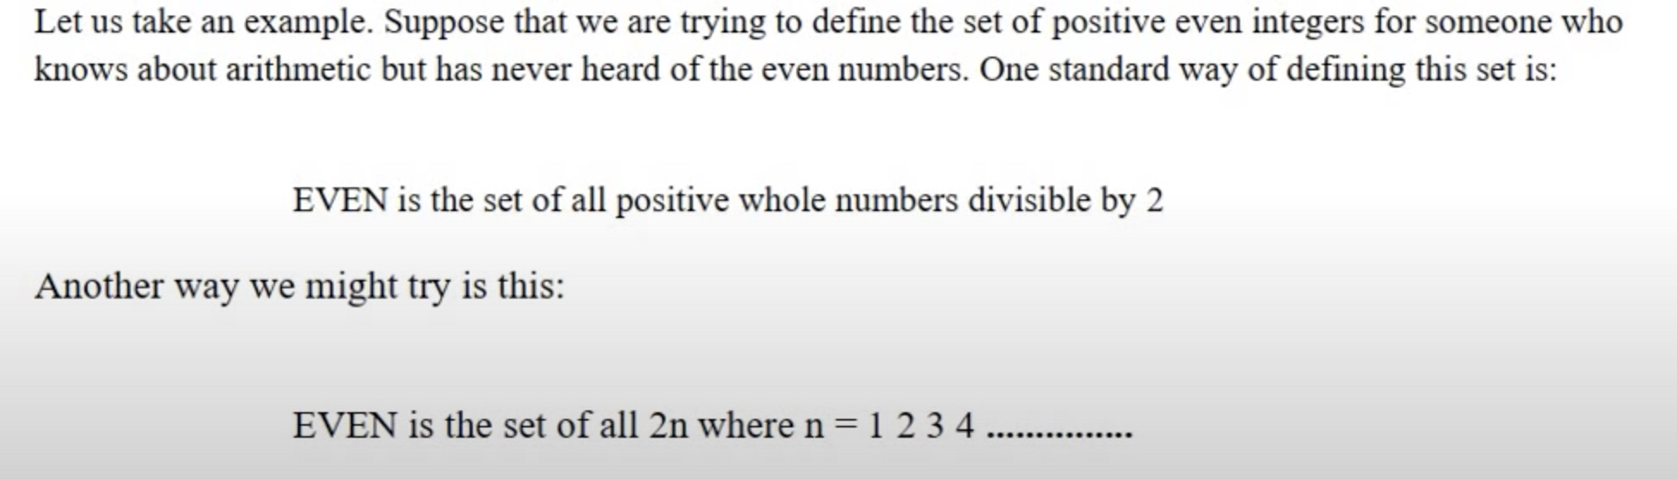
Example 1

Slide 33
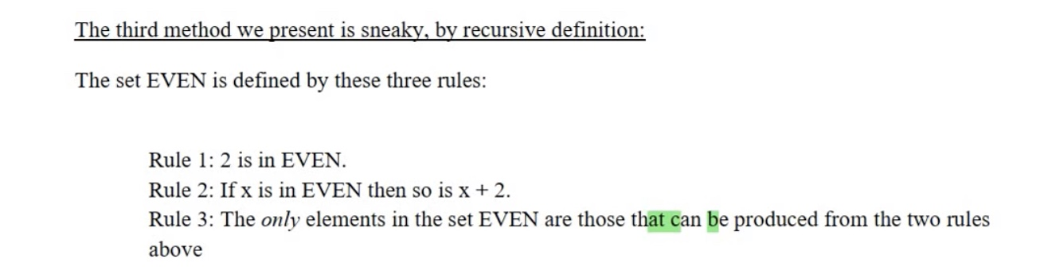
Example 1

Slide 34
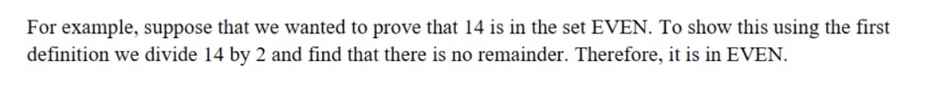
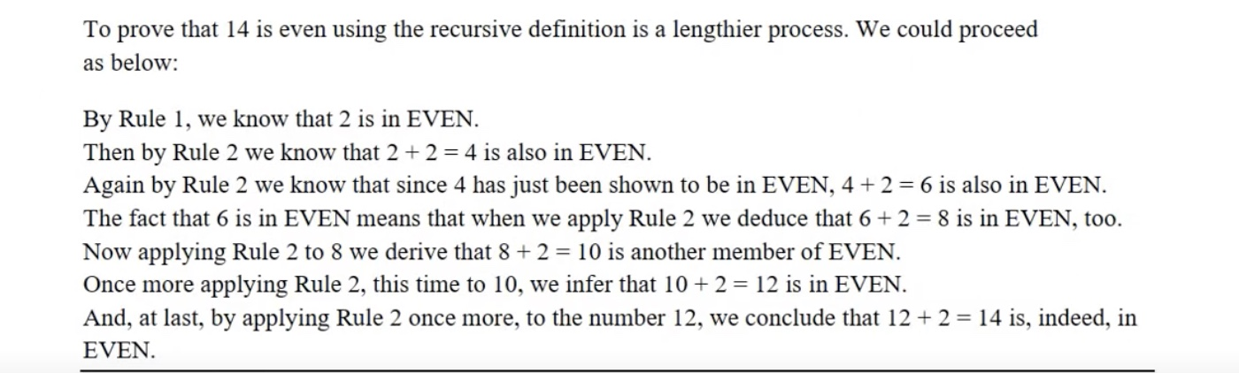
Applying the recursive approach from example 1

Slide 35
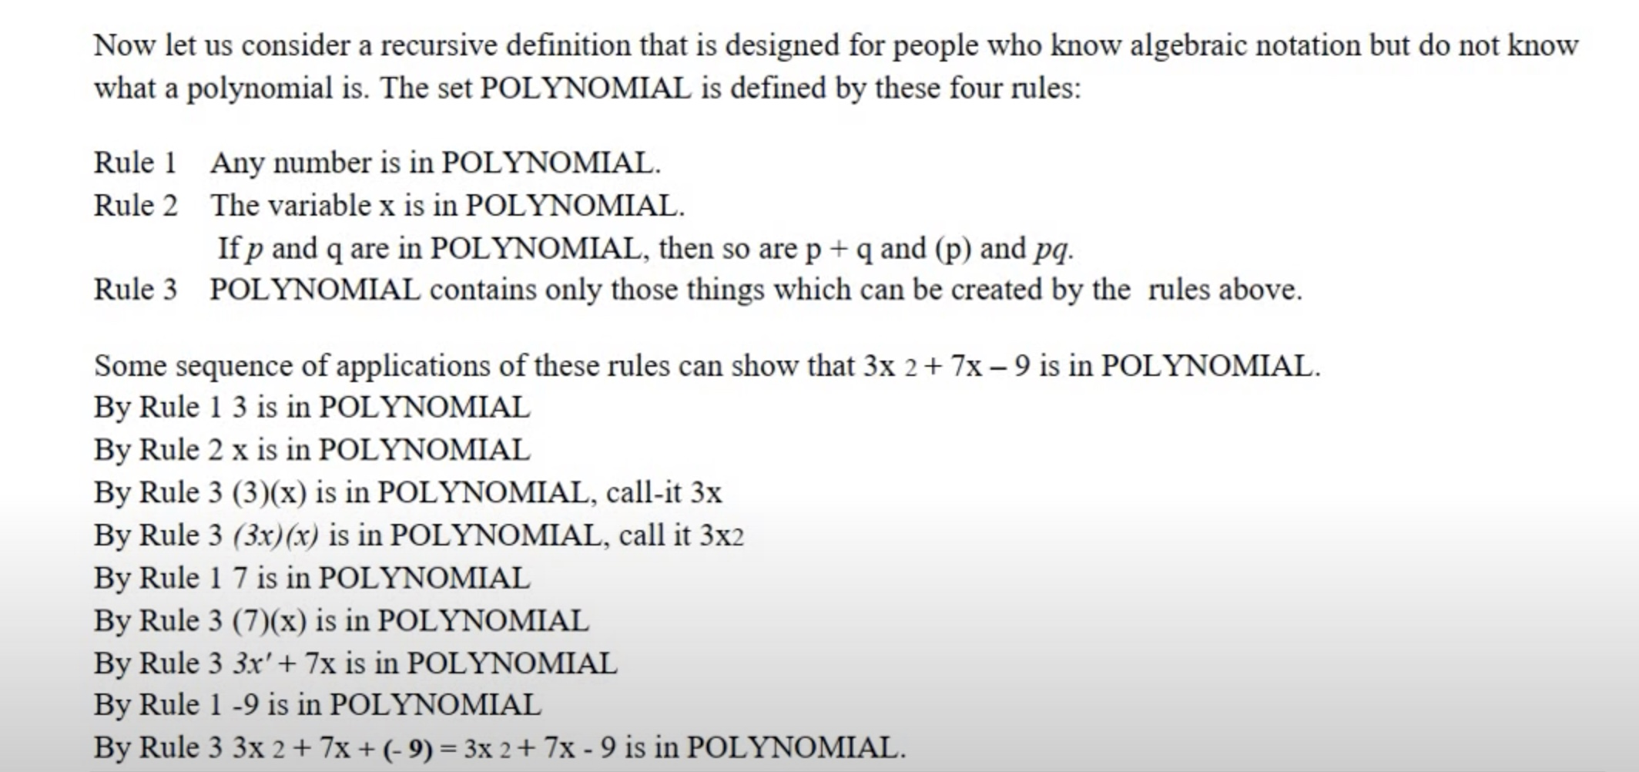
Example 2

Slide 36
Practise Questions from Example 2
1.) 9x² +3y²+7xy-9
2.) -3xy² +12x²-7

Slide 37
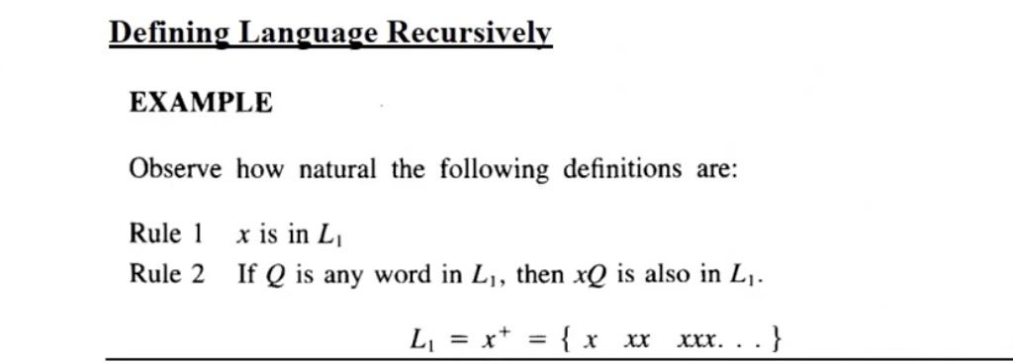
How to define a language recursively?

Slide 38
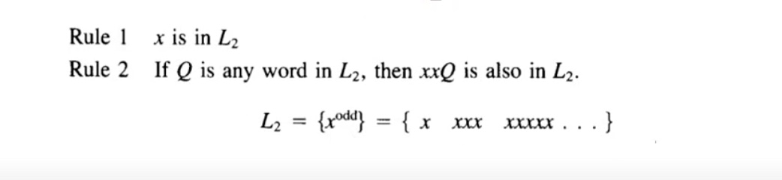
Cont..

Slide 39
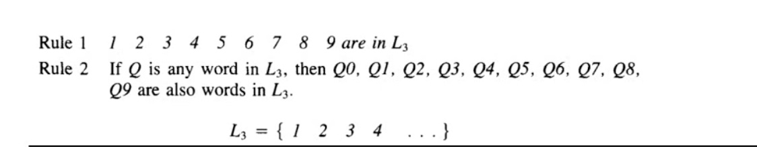
Example
Will this language have all numbers?

Slide 40
End of Lecture

